Slide 1
Deep Appearance Maps
Tobias Ritschel
Joint work with Maxim Maximov and Mario Fritz
https://arxiv.org/abs/1804.00863
Notes:
Stereo cannot reproduced using the equipment we have here, so I show wiggly stereo.
The two images that each eye see are different by some horizontal offset called disparity.
By matching the two image, the human visual system perceives depth.
Can we predict what depth details are perceived from this?

Slide 2
Computer graphics
Representation
$$\left(\begin{aligned}x \\ y \\ z \\ a \\ b \\ c\end{aligned}\right)$$
Light
Material
Notes:
Stereo cannot reproduced using the equipment we have here, so I show wiggly stereo.
The two images that each eye see are different by some horizontal offset called disparity.
By matching the two image, the human visual system perceives depth.
Can we predict what depth details are perceived from this?

Slide 3
Computer Vision
$$\left(\begin{aligned}x \\ y \\ z \\ a \\ b \\ c\end{aligned}\right)$$
Light
Material
Notes:
Stereo cannot reproduced using the equipment we have here, so I show wiggly stereo.
The two images that each eye see are different by some horizontal offset called disparity.
By matching the two image, the human visual system perceives depth.
Can we predict what depth details are perceived from this?

Slide 4
Deep Learning
$$\left(\begin{aligned}x \\ y \\ z \\ a \\ b \\ c\end{aligned}\right)$$
Light
Material
Notes:
Stereo cannot reproduced using the equipment we have here, so I show wiggly stereo.
The two images that each eye see are different by some horizontal offset called disparity.
By matching the two image, the human visual system perceives depth.
Can we predict what depth details are perceived from this?

Slide 5
CVPR 2014
Maps aligned pixels to pixels from new views
Not much learned
With KU Leuven and MPI

Slide 6
PAMI 2016
With KU Leuven, U Washington and MPI
Maps pixels to pixels from new views
SVM to regress views

Slide 7
CVPR 2016
Maps normals to appearance (reflectance maps)
Deep learning
With KU Leuven, U Washington and MPI

Slide 8
PAMI 2017
With KU Leuven, U Washington and MPI
Maps reflectance maps to BRDF parameters

Slide 9
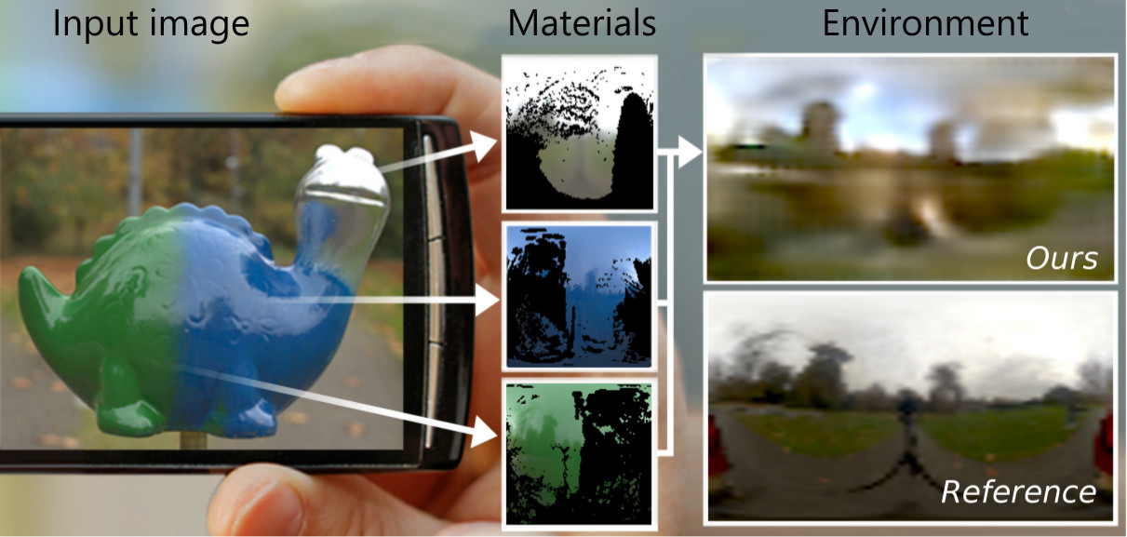
ICCV 2017
With KU Leuven, U Washington and MPI
Maps pixels to illumination (envmap)

Slide 10
EGSR 2017
With MPI
Maps pixels with attributes to appearance

Slide 11
CGF 2018
With Tuanfeng and Niloy (conditional accept)
Maps pixels from multiple images to illumination and BRDF

Slide 12
Representation?
?
Notes:
Stereo cannot reproduced using the equipment we have here, so I show wiggly stereo.
The two images that each eye see are different by some horizontal offset called disparity.
By matching the two image, the human visual system perceives depth.
Can we predict what depth details are perceived from this?

Slide 13
Key idea
?
Notes:
Stereo cannot reproduced using the equipment we have here, so I show wiggly stereo.
The two images that each eye see are different by some horizontal offset called disparity.
By matching the two image, the human visual system perceives depth.
Can we predict what depth details are perceived from this?

Slide 14
Reflectance maps
Maps surface orientations to color
One BRDF
One illumination
One image
That’s it
Next time sb/you makes appearance fuzz consider comparing to this 1-liner

Slide 15
Limitation: DIffuse

Slide 16
Limitations: spec+Dif

Slide 17
Appearance is 4D
2D Surface orientation
2D view direction
(Still fixed light and material)

Slide 18
Three tasks

Slide 19
Representation Task

Slide 20
Dataset

Slide 21
Representation task
NN parameters
Adversarial
parameters
Data cost
Weight
Adversarial cost

Slide 22
Data term
NN appearance
Given appearance

Slide 23
Adversarial term

Slide 24
Qualitative Results

Slide 25
Qualitative Results

Slide 26
Quantitative Results

Slide 27
Quantitative Results

Slide 28
Learning-to-Learn Task

Slide 29
Formalization
Input image
NN producing NN
NN’s parameters

Slide 30
Qualitative Results

Slide 31
Qualitative Results

Slide 32
Quantitative Results

Slide 33
Quantitative Results

Slide 34
Segmentation Task

Slide 35
Segmentation Task
NN-making mask
Mask sparsity prior
Its parameters

Slide 36
Results

Slide 37
Limitations

Slide 38
Fun CG App: MC Filtering

Slide 39
Future work
Factor appearance into light and BRDF
Learning-to-learn segmentation
Spatio-temporal localized learning-to-learn

Slide 40
Thank
Special thanks to Denis and Martin for organizing and Martin for giving me his slot

Slide 41
Lots of hoops
“Can jump through a lot of hoops”
This is fun
But it would take, say, Tim or me 4 hs per app to be better
Learning-to-learn blew my mind
If you have some CG-foo can show you do better
If this is really the way to go is not known

